Slide 1

COMMUNICATION
Presented by:
Jiaqi Wang 001023711
Mayank Mansinghka 001057581
Vagisha Deo Prakash 002100987

Slide 2
preview
What does communication mean to you?
How can you manage time with communication?
How does time management help in business communication?
How effective can time management be in managing relationships?

Slide 3
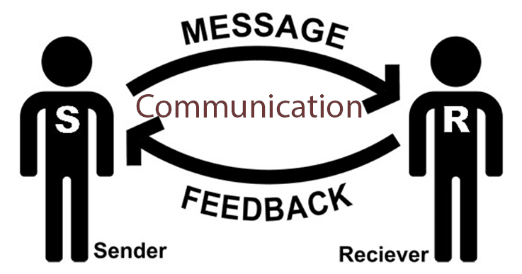
What does communication mean to you?

Slide 4

How can you manage time with communication?
Make
Give
Give timely feedback to focus on behavior and impact
Establish
Establish regular one-to-one communication channels
Make sure the goal is clear

Slide 5

How does time management help in business communication?
To attain organizational effectiveness
Enhances employee motivation, morale, and productivity
Importance to communication between organization and its customers

Slide 6
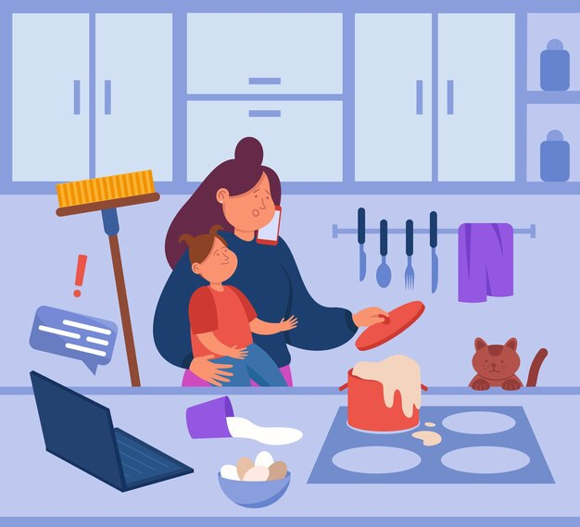
How effective can time management be in managing relationships?
Spending it where it matters the most
Healthy work-life balance
Not bringing office home.

Slide 7
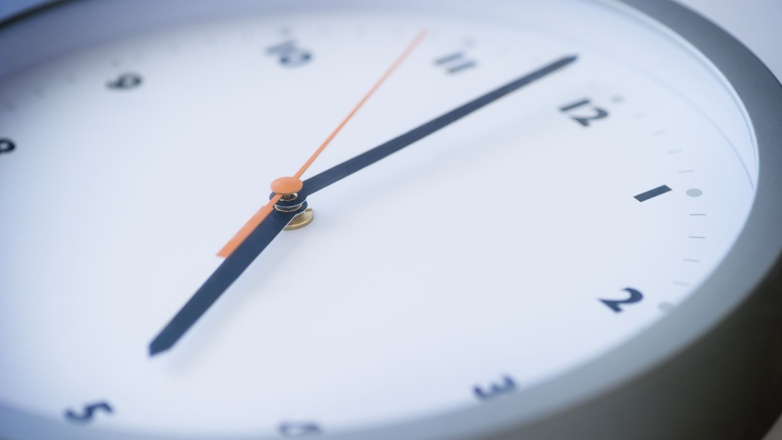
Thank you for your time!

